Slide 1
Plotting and Visualization
Please do a git pull
Lars Ailo Bongo
larsab@cs.uit.no
Dep. of Computer Science and NELS@UiT, University of Tromsø

Slide 2
Overview
Matplotlib
Short introduction
Exercises
Advanced visualizations in Python
Graphviz/ networkx
Tkinter/ pygame
Exercise

Slide 3
Visualization tools
Excel, …
MATLAB, …
R, …
Tableu, …
Paraview, …
Web apps
OpenGL, …
Process, …
Python, …
Gnuplot, …

Slide 4
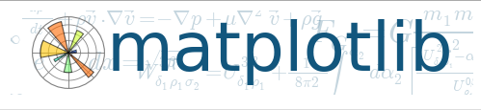
“matplotlib is a python 2D plotting library which produces publication quality figures in a variety of hardcopy formats and interactive environments across platforms. matplotlib can be used in python scripts, the python and ipython shell”
http://matplotlib.org/

Slide 5
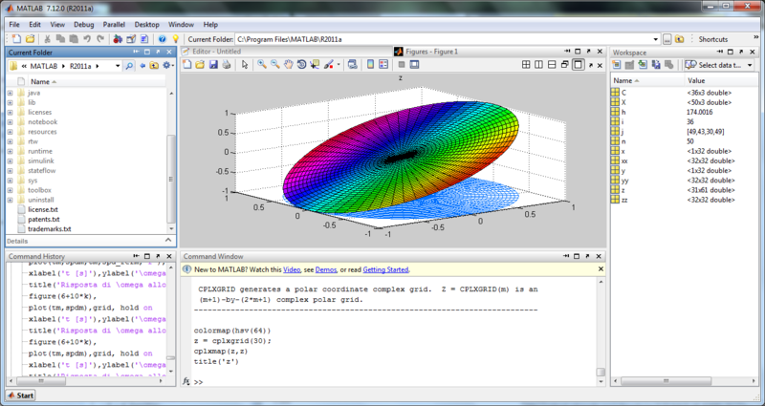
MATLAB
Image from wikipedia

Slide 6
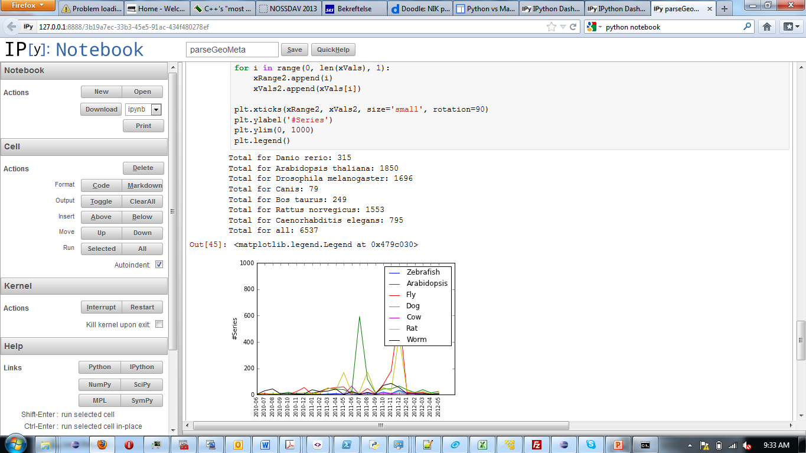
IPython Notebook

Slide 7
MATLAB vs. Python
Easy to use
Lots of functions
Large scientific user community
Commercial product
Portability issues
Easy to use (if you know Python)
Lots of functions
Lots of modules/ libraries
Portable
Computer scientists/ hackers love it

Slide 8
Disclaimer
Visualization in Python is not great
Many modules for doing the same thing
Resulting visualizations tend to be ugly
Big and messy interfaces
May require advanced programming

Slide 9
Hello Plotting World!
from numpy import linspace, sin
# create 100 numbers between 0 and 10
x = linspace(0, 10, 100)
import matplotlib.pyplot as plt
plt.plot(x, sin(x))
# Show GUI with plot plt.show() # blocking call

Slide 10
Hello PyLab Plotting World!
from numpy import linspace, sin
# create 100 numbers between 0 and 10
x = linspace(0, 10, 100)
import matplotlib.pyplot as plt
plt.plot(x, sin(x))
# Show GUI with plot. plt.show() # blocking call

Slide 11
Hello PyLab Plotting World!
# create 100 numbers between 0 and 10
x = linspace(0, 10, 100)
plot(x, sin(x))

Slide 12
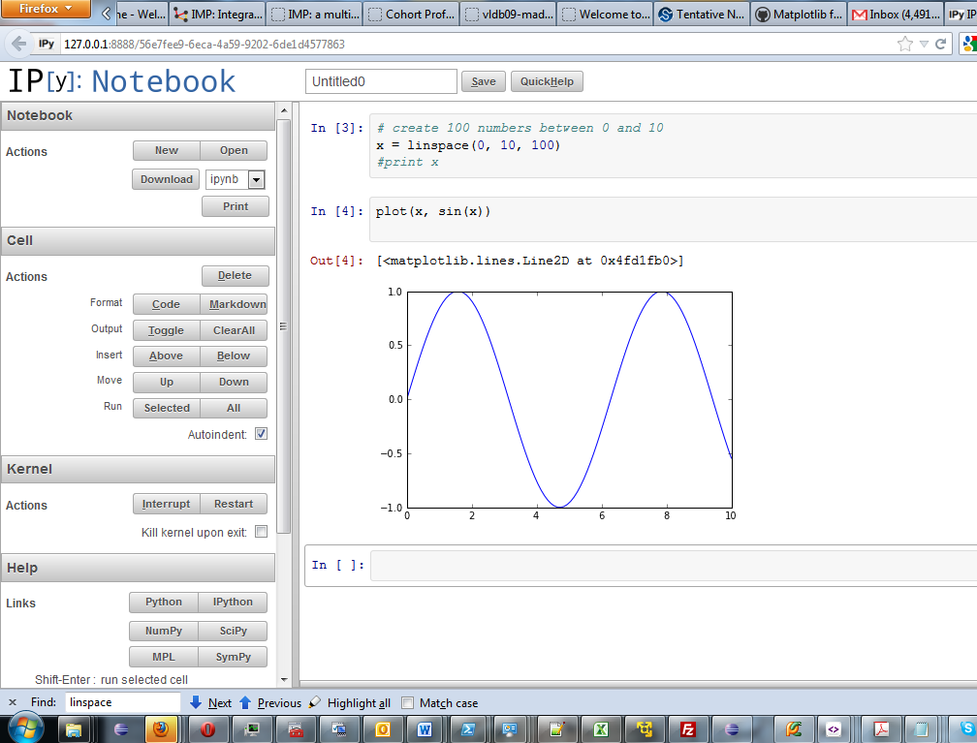

Slide 13
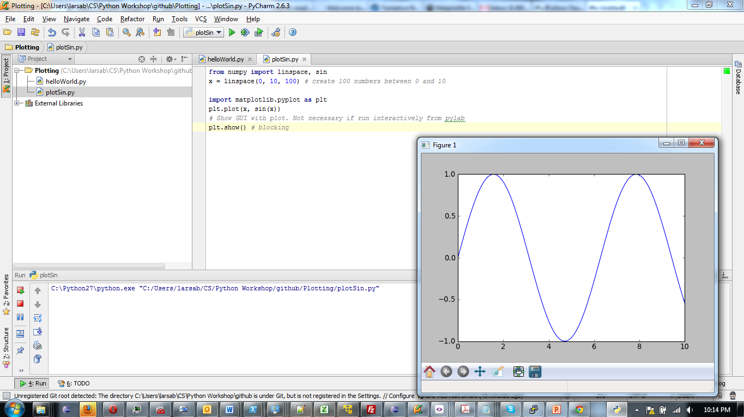

Slide 14
Exercise I
# Data values
N = 10
y = []
for i in range(N):
y.append(2**i)
# X-axis ticks
x = []
for i in range(N):
x.append('2^%d' % (i))

Slide 15
Exercise I (part 2)
fig = plot(y, color='red')
plt.title('Power of 2')
plt.xticks(xrange(10), x, size='small', rotation=90)
plt.ylabel('y = 2^x')
plt.ylim(0, 2**(N-1))
plt.yscale('log')
plt.show() # if not in pylab
plt. savefig(‘helloworld.png', type='png')

Slide 16
Exercise II
matplotlib as everybody else is using it
Create a Python data structure with a toy dataset that you would like to visualize
Open: http://matplotlib.org/gallery.html
Click on the visualization you want to use
Tip: pick a simple one
Adapt the example code for your data

Slide 17
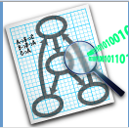
Graphviz
Graph visualization
Takes care of graph layout
NetworkX package provides Pyhton wrapper:
http://networkx.lanl.gov/

Slide 18
Graph Example
import networkx as nx
import matplotlib.pyplot as plt
# Crate graph object
G = nx.Graph()
# First add nodes
G.add_node('A')
G.add_node('B')
G.add_node('C')
G.add_node('D')
# and calculate position of nodes
pos = nx.spring_layout(G, iterations=200)

Slide 19
Graph Example (part 2)
# Then add edges
G.add_edge('A', 'B')
G.add_edge('A', 'C')
G.add_edge('C', 'D')
# Set edge styles and labels
nx.draw_networkx_edges(G, pos, edgelist=[('A', 'C')], style='dotted')
nx.draw_networkx_edge_labels(G, pos, edge_labels={('C', 'D'): 'a label'})
# Set node styles
nx.draw(G, pos, node_color=['red', 'green', 'blue', 'yellow'])
# Show graph
plt.show()

Slide 20
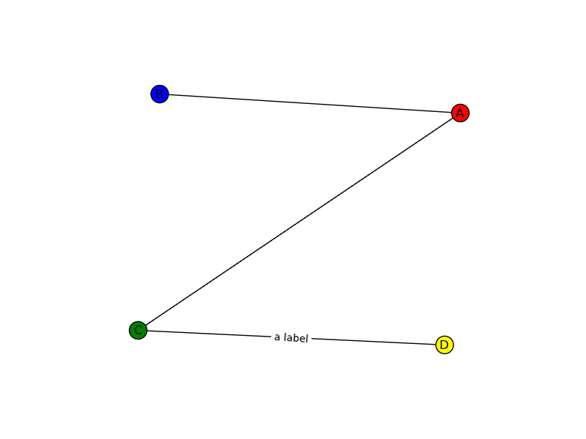
Graph Example (result)

Slide 21
Tkinter
“Tkinter is Python's de-facto standard GUI (Graphical User Interface) package. It is a thin object-oriented layer on top of Tcl/Tk.”
There are better alternatives
We will use it to demonstrate how to use a canvas to create custom visualizations

Slide 22
Tkinter Example
from Tkinter import *
# Setup Tkinter
root = Tk()
# Create canvas with a vertical scrollbar, set window # position and size
<complicated stuff>
# Add a few rectangles
canvas.create_rectangle(100, 200, 150, 300, fill="red")
canvas.create_rectangle(100, 700, 200, 750, fill="green")
canvas.create_rectangle(400, 100, 450, 800, fill="blue")
# Add some text
canvas.create_text(10, 10, text="Hello world!", anchor=NW)
# Enter GUI loop
mainloop() # block until user closes window

Slide 23

“Pygame is a set of Python modules designed for writing games. Pygame adds functionality on top of the excellent SDL library. This allows you to create fully featured games and multimedia programs in the python language. Pygame is highly portable and runs on nearly every platform and operating system.”
http://www.pygame.org/

Slide 24
Pygame
Easy to use library for creating custom visualizations
Not part of EPD
Hello world script is in github

Slide 25
Exercise III
Write a heatmap visualizer for microarray expression values
Using either Tkinter or pygame
heatmap.py provides useful code
GSE5955-GPL2112.final.pcl is a sample input file
bta.map is a sample mapping file

Slide 26
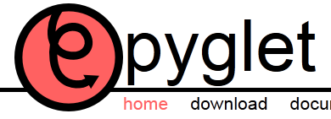


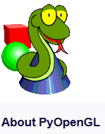

More graphics libraries

Slide 27
Summary
Python not great for visualization…
…but great when combined with other (powerful) libraries
Matplotlib + pylab = almost MATLAB
Pygame nice for custom visualizations
Many other libraries

